Slide 1
Project 2.2
Daniel Chawla, Amber Jessop, Olivia Justynski

Slide 2
CRISPR and personal genomics: The impact of SNPs on sgRNA sets and off target mutations.

Slide 3
Writing
How might SNPs in Carl’s genome impact the use of CRISPR as a treatment? Discuss how individual SNPs would impact the off-target effects in the presence of the SNP.

Slide 4
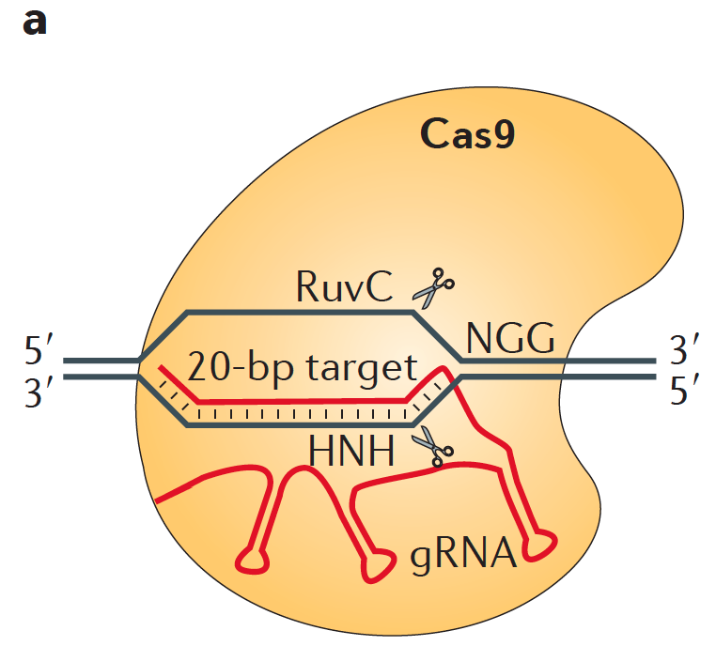

Slide 5
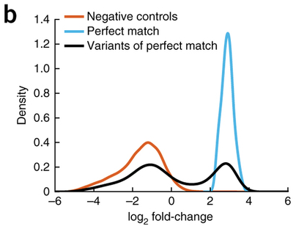

Slide 6
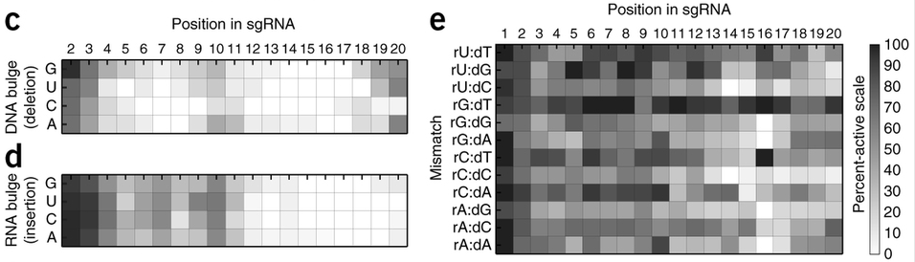

Slide 7
Coding
Propose a tool that finds PAM sites in the human reference genome as well as Carl’s genome and compares the similarity of the two sets.

Slide 8
Pipeline
Calculate the sgRNA libraries for the reference genome and Carl’s genome. How different are these two sets?

